Slide 1
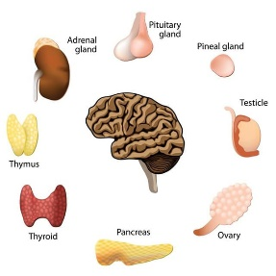
University of Basrah Ministry of Higher education Al-Zahraa Medical College and Scientific Research
Block: Metabolic block
Lecture: Renal replacement therapy
Lecturer: Dr.Mohammed Adel
Block staff:
Dr.Ahmed jaafer (block leader) Dr.Ahmed qasim Dr. Majid hameed dr. mohammed Adel
Dr. Daihgum imad Dr.Ahmed ibraheem Dr. Mohammed mehdi Dr .Ammar mohammed
Davidson's Principles and Practice of Medicine
HARRISON’S PRINCIPLES OF INTERNAL MEDICINE
WILLIAMS textbook of ENDOCRINOLOGY
PEDIATRIC PRACTICE Endocrinology
Oxford Handbook of Endocrinology and Diabetes

Slide 2
Learning objectives:
1- introduction to renal replacement therapy
2- indication of renal replacement therapy
3- brief notes about HD and PD
4- knowledge about renal transplant

Slide 3
Renal replacement therapy
Renal replacement therapy (RRT) may be required on a temporary basis in patients with AKI or on a permanent basis for those with advanced CKD.
Survival on dialysis is strongly influenced by age and presence of complications such as diabetes. For this reason, conservative care rather than RRT may be a more appropriate option for older patients or those with extensive comorbidities.
The aim of RRT is to replace the excretory functions of the kidney and to maintain normal electrolyte concentrations and fluid balance. Various options are available, including haemodialysis, haemofiltration, haemodiafiltration, peritoneal dialysis and renal transplantation.

Slide 4
Conservative treatment
In older patients with multiple comorbidities, conservative treatment of stage 5 CKD, aimed at limiting the adverse symptoms of ESRD without commencing RRT, is increasingly viewed as a positive choice.
Current evidence suggests that survival of these patients without dialysis can be similar or only slightly shorter than that of patients who undergo RRT, but they avoid the hospitalisation and interventions associated with dialysis.
Patients are offered full medical, psychological and social support to optimise and sustain their existing renal function and to treat complications, such as anaemia, for as long as possible, with appropriate palliative care in the terminal phase of their disease.

Slide 5
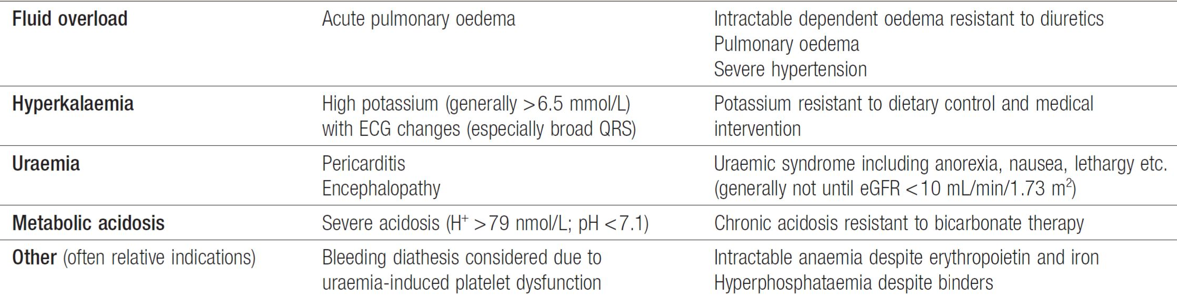
Indication of dialysis :

Slide 6
Haemodialysis :
Haemodialysis is the most common form of RRT in ESRD and is also used in AKI. Haemodialysis involves gaining access to the circulation, either through a central venous catheter or an arteriovenous fistula or graft.
The patient’s blood is pumped through a haemodialyser, which allows bidirectional diffusion of solutes between blood and the dialysate across a semipermeable membrane down a concentration gradient.
The composition of the dialysate can be varied to achieve the desired Gradient.

Slide 7
Haemodialysis offers the best rate of small solute clearance in AKI, compared with other techniques such as hemofiltration, but should be started gradually because of the risk of delirium and convulsions due to cerebral oedema
In CKD, vascular access for haemodialysis is gained by formation of an arteriovenous fistula (AVF), usually in the forearm, up to a year before dialysis is contemplated.
Preservation of arm veins is thus very important in patients with progressive renal disease who may require haemodialysis in the future.
All patients must be screened in advance for hepatitis B, hepatitis C and HIV, and vaccinated against hepatitis B if they are not immune. All dialysis units should have segregation facilities for hepatitis B-positive patients, given its easy transmissibility.
Haemodialysis is usually carried out for 3–5 hours three times weekly, either at home or in an outpatient dialysis unit

Slide 8
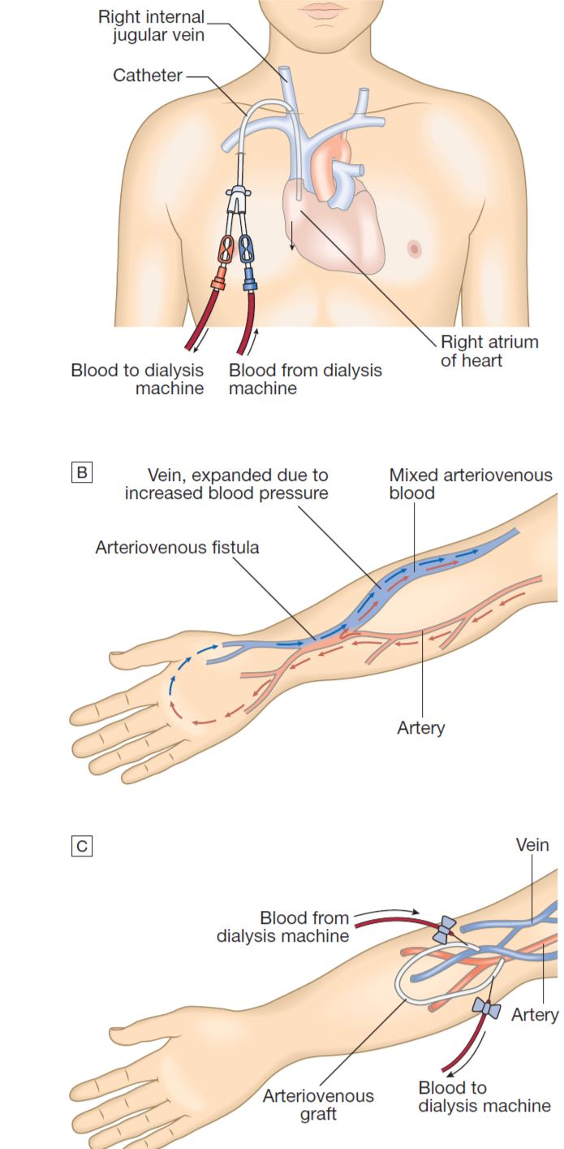

Slide 9
Peritoneal dialysis
Peritoneal dialysis is principally used in the treatment of CKD, though it may occasionally be employed in AKI. It requires the insertion of a permanent catheter into the peritoneal cavity.
Two types are in common use.
Continuous ambulatory peritoneal dialysis (CAPD), about 2 L of sterile, isotonic dialysis fluid are introduced and left in place for approximately 4–6 hours.
Automated peritoneal dialysis (APD) is similar to CAPD but uses a mechanical device to perform the fluid exchanges during the night, leaving the patient free, or with only a single exchange to perform, during the day
CAPD is particularly useful in children, as a first treatment in adults with residual renal function, and as a treatment for elderly patients with cardiovascular instability.

Slide 10
Problems with continuous ambulatory peritoneal dialysis:
Peritonitis
Catheter exit site infection.
Ultrafiltration failure.
Peritoneal membrane failure.
Sclerosing peritonitis.

Slide 11
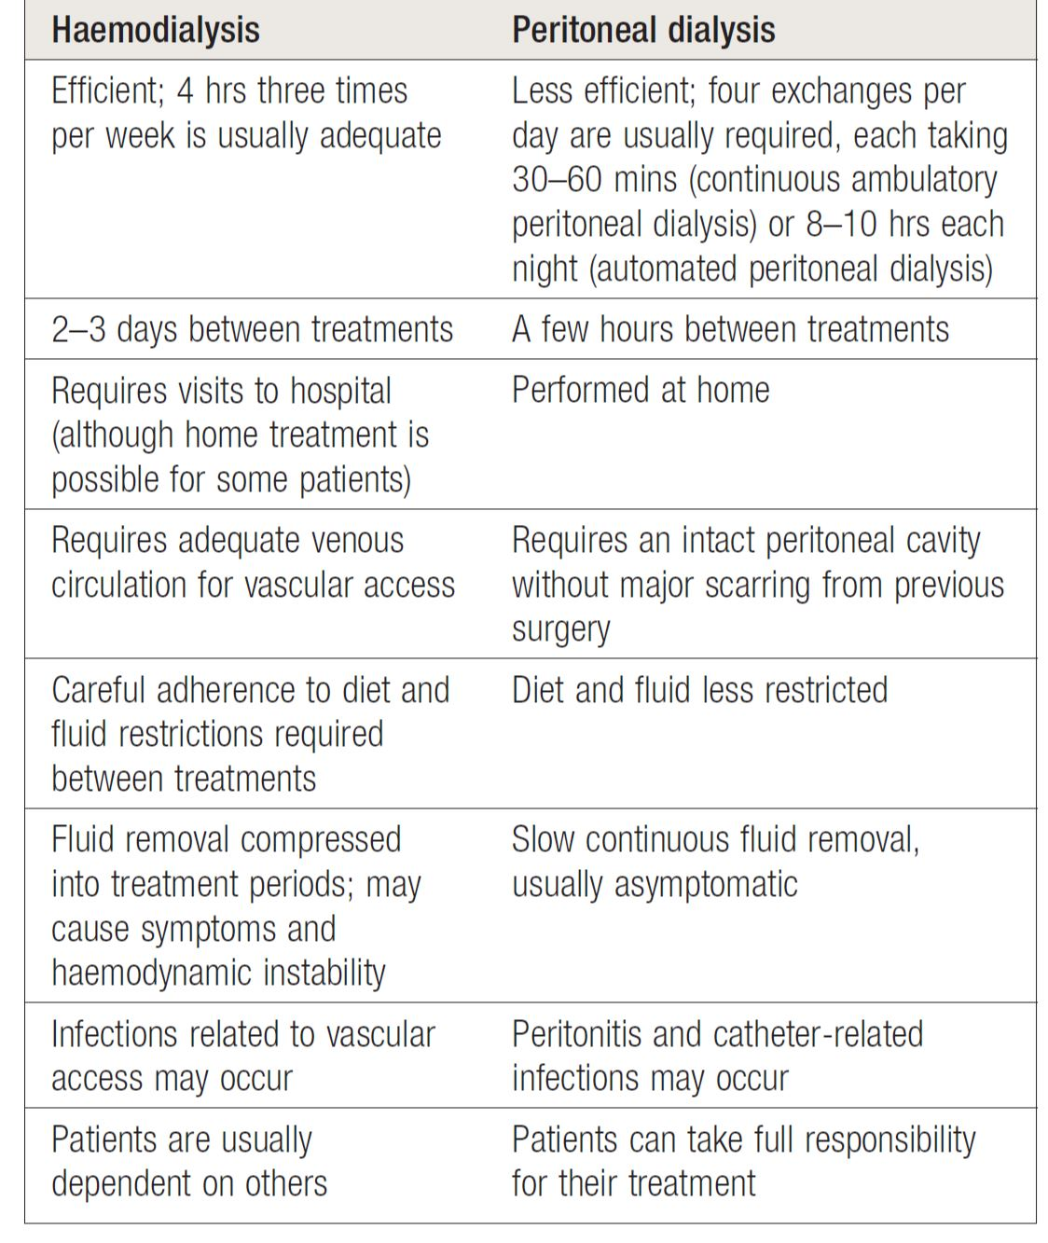

Slide 12
Renal transplantation:
Renal transplantation offers the best chance of long-term survival in ESRD and is the most cost-effective treatment. All patients with ESRD should be considered for transplantation but many are not suitable due to a combination of comorbidity and advanced age (although no absolute age limit applies).
Contraindications:
Absolute contraindications for kidney transplantation are:
The inability to tolerate surgery due to severe cardiac or pulmonary disease.
Active malignancy.
Active infection.
Active drug abuse.
Uncontrolled psychiatric disease.
Vasculitis.
High risk of recurrence of renal disease.

Slide 13
Kidney grafts may be taken from a deceased donor in the UK after brain death (40%) or circulatory death (24%), or from a living donor (36%).
Compatibility of ABO blood group between donor and recipient is usually required and the degree of matching for major histocompatibility (MHC) antigens, particularly human.
leucocyte antigen DR (HLA-DR), influences the incidence of rejection. During the transplant operation, the kidney is placed in the pelvis; the donor vessels are usually anastomosed to the recipient’s external iliac artery and vein, and the donor ureter to the bladder.
All transplant patients require regular life-long follow-up to monitor renal function and complications of immunosuppression.
A common regimen is triple therapy with prednisolone; ciclosporin or tacrolimus; and azathioprine or mycophenolate mofetil.

Slide 14
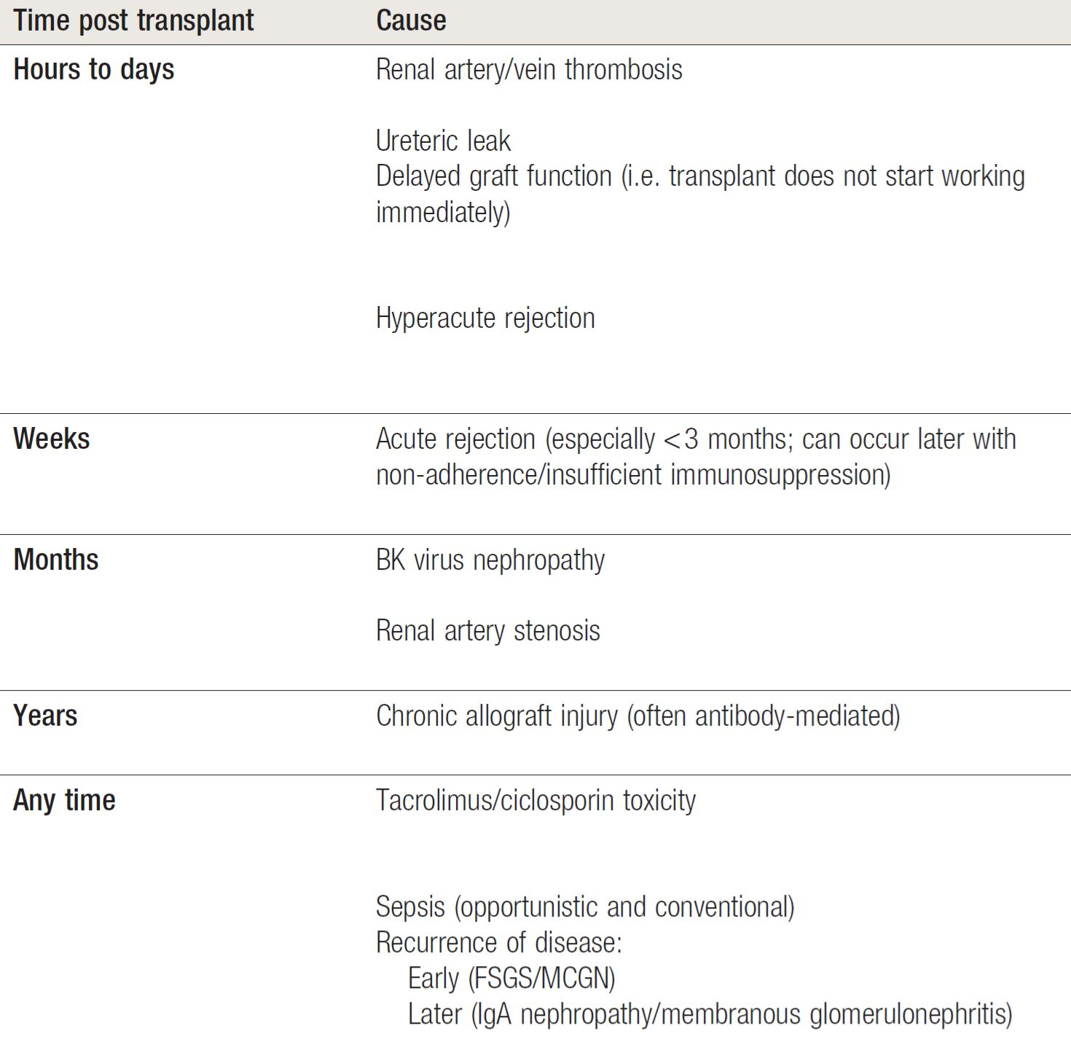
Common causes of renal allograft dysfunction:

Slide 15
Thank you

